Slide 1
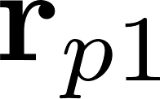

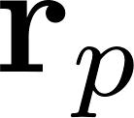
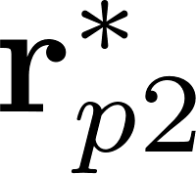

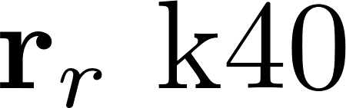
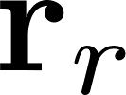
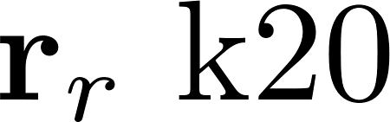
signal strip
inner product
arg and scale
average
derotate
samples
copy samples

Slide 2

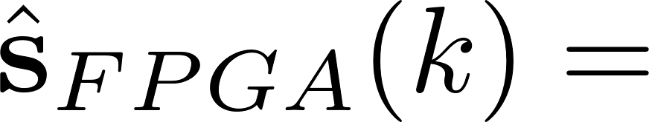


Slide 3

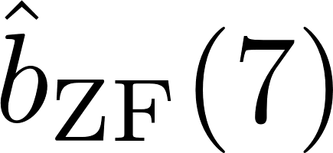
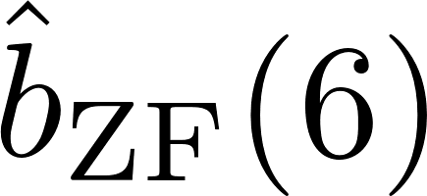
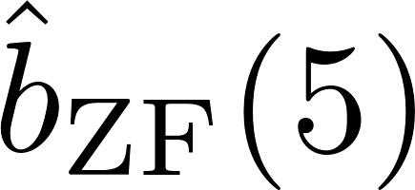
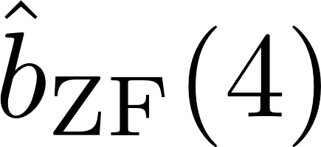
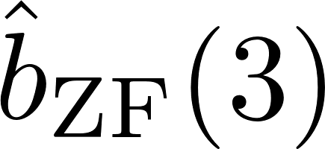
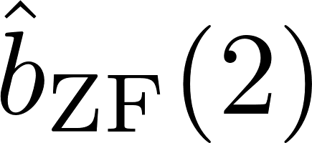
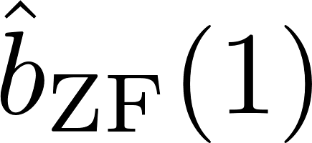
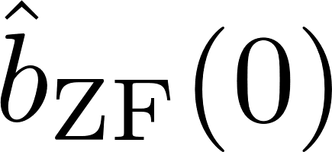





Slide 4
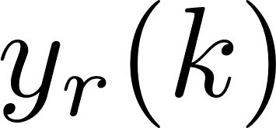
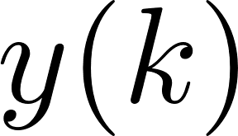
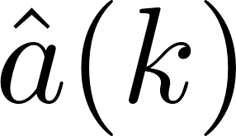
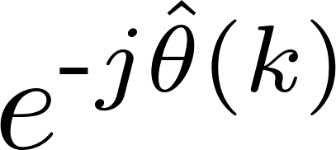
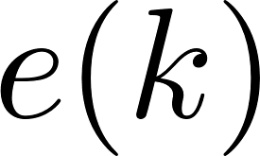

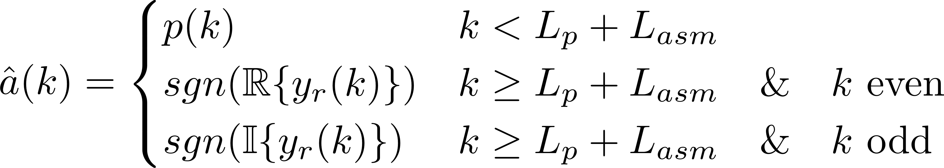
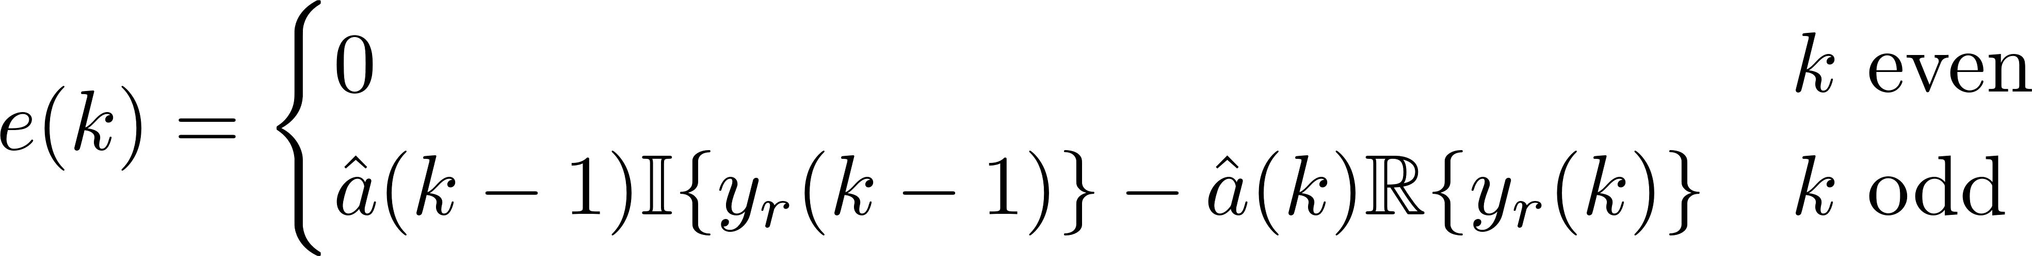
Demod
DDS
PED

Slide 5


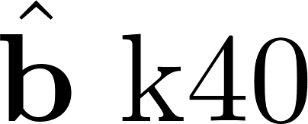
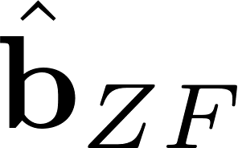


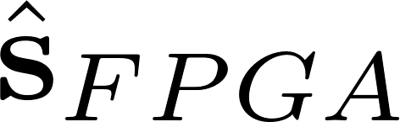
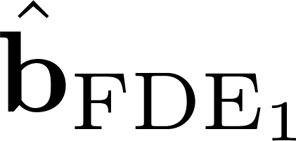
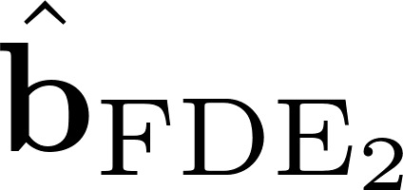
OQPSK
demod
bit
prune
copy
bits
bit interleave

Slide 6

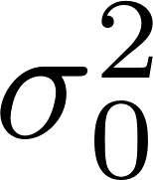
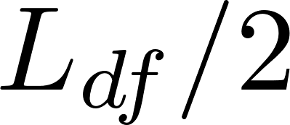


Apply FDE1 or FDE2
zero pad
FFT
zero pad
FFT
IFFT
prune
zero pad
FFT
zero pad
FFT
IFFT
prune

Slide 7


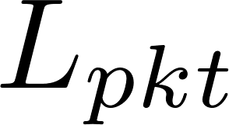
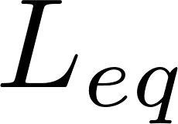
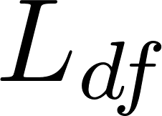
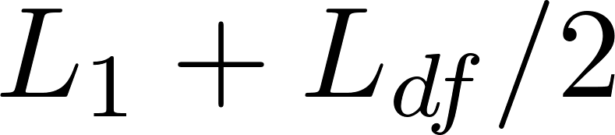
Apply FIR Filter
convolution

Slide 8


FDE1
zero pad
FFT
zero pad
FFT

Slide 9

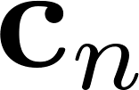


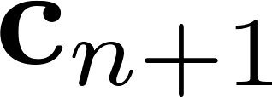

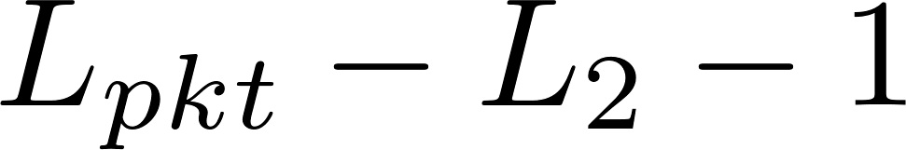
CMA apply
convolution
compute
z
reverse
convolution
reverse
update
coeff

Slide 10
CMA apply
convolution
reverse
reverse
compute

Slide 11


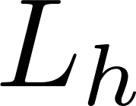
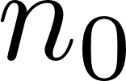
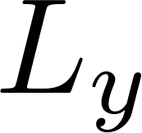


Simple conv
convolution
convolution
convolution

Slide 12
FFT conv
zero pad
FFT
zero pad
FFT
IFFT
prune
zero pad
FFT

Slide 13
FFT conv
zero pad
FFT
IFFT
prune
zero pad
FFT

Slide 14


Convolution

Slide 15
signal strip
inner product
arg and scale
average
derotate
samples
copy samples

Slide 16


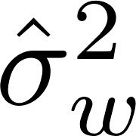

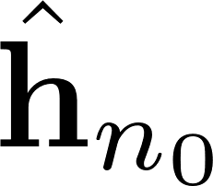

auto-corr
fill
build
sparse
solver

Slide 17
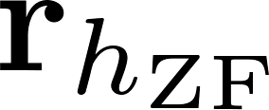
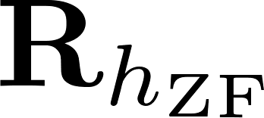

auto-corr
fill
build
sparse
solver

Slide 18
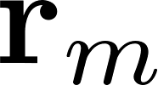
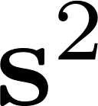

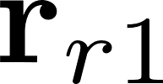
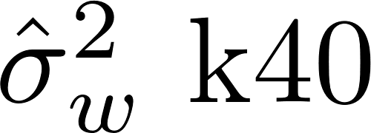
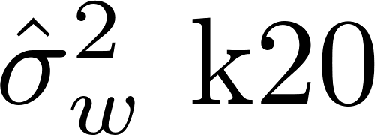
matrix
multiply
sub and
square
sum and
scale
copy samples

Slide 19
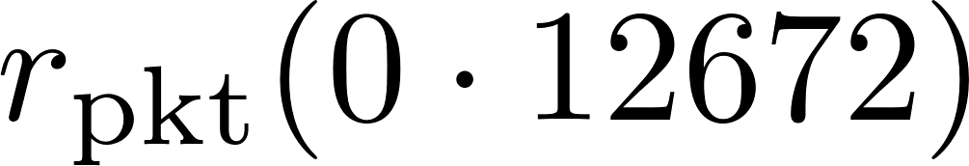
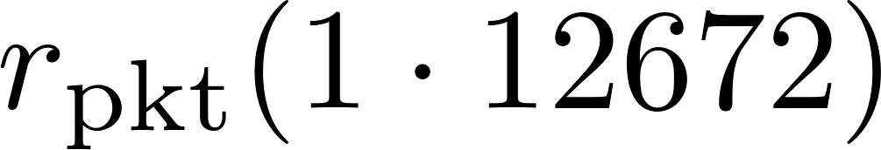


packet
packet o
packet
packet
…

Slide 20





packet
packet o
partial
packet
packet
packet
partial
packet
…
data
6144 bits
preamble
128 bits
ASM
64 bits
data
6144 bits
preamble
128 bits
ASM
64 bits
12672 sample packet
preamble
256 samples
ASM
128 samples
data
12288 samples
data
12288 samples
data
12288 samples
preamble
256 samples
ASM
128 samples
data
12288 samples
preamble
256 samples
ASM
128 samples
…
…

Slide 21




packet
packet
packet
packet
…

Slide 22




signal strip
matrix
multiply
signal strip
matrix
multiply
copy samples
signal strip
matrix
multiply
copy samples

Slide 23
signal strip
inner product
arg and scale
average
derotate
samples
copy samples

Slide 24











sums
sum
first max search
search all max
longest chain search
packetize samples
preamble detector
sums
sum
first max search
search all max
longest chain search
packetize samples

Slide 25

preamble
detector
estimate & compensate
frequency
offset
estimate
channel &
noise var.
compute & apply
equalizers
SxS
Demod
bits
(to BERT)
frame
sync
frequency
offset
comp
estimate
channel
estimate
noise
compute & apply
equalizers
SxS
demod
bits
(to BERT)

Slide 26

ribbon cable
(I/Q samples @ 2 samples/bit, 12 bits/sample)
PCIe bus
PCIe bus
modified
telemetry receiver
FPGA
interface
circuit
host
computer
GPU
Nvidia K40
QSX-RDMS-RM2-Q-1100-X2
GPU
Nvidia K20
BERT
ch 1
FPGA
interface
circuit
ch 2
ch 3
GPU
Nvidia K20
ch 4
ch 5
ch 6
ch 7
clock/data
ch 8
Reach Technologies BERT-50S-8

Slide 27
ribbon cable
(I/Q samples @ 2 samples/bit, 12 bits/sample)
PCIe bus
PCIe bus
multicoupler
modified
telemetry receiver
(1800.5 MHz)
FPGA
interface
circuit
host
computer
GPU
Nvidia K40
QSX-RDMS-RM2-Q-1100-X2
GPU
Nvidia K20
FPGA
interface
circuit
Bldg. 12
antenna 10, RHCP
10’ parabolic reflector
to BERT
channels 1-5
GPU
Nvidia K20
clock/data
multicoupler
telemetry receiver
(1771.5 MHz)
Xlinx FMC XM105
Xlinx ARTIX-7 FPGA AC701
ZF
BERT
ch 1
MMSE
ch 2
from FPGA interface circuit
ICMA
ch 3
QSX-RDMS-3R1D-A1-1111-00-14-EQ-K7
FDE1
ch 4
telemetry receiver w/EQ
(1771.5MHz)
FDE2
ch 5
ch 6
ch 7
QSX-RDMS-3R1D-A1-1111-00-14-EQ-K7
ch 8
telemetry receiver
(1800.5MHz)
clock/data
preamble
detector
(FPGA)
Reach Technologies BERT-50S-8
spectrum analyzer
Mu-Del 2MDP-22400
QSX-RDMS-RM2-Q-1100-X2
to antenna tracking receivers
Mu-Del 2MDP-22400
Agilent E4407 B

Slide 28
766 bits
of the pn9 sequence
preamble
128 bits
ASM
64 bits
767 bits
of the pn9 sequence
0
0

Slide 29
packet
packet
data
6144 bits
preamble
128 bits
ASM
64 bits
data
6144 bits
preamble
128 bits
ASM
64 bits
data
12288 samples
data
12288 samples
preamble
256 samples
ASM
128 samples
data
12288 samples
preamble
256 samples
ASM
128 samples
…
…
12672 sample packet
preamble
256 samples
ASM
128 samples
data
12288 samples

Slide 30
data
samples
ASM
samples

Slide 31
data
samples
ASM
samples

Slide 32
i samples corresponding to the data preceding the preamble
L_{p} samples correspond-ing to the preamble
L_{a} samples corres-ponding to the ASM
L_{d} samples corresponding to the 6144 data bits after the pre-amble and ASM
samples corres-ponding to the next preamble
L_{p} + L_{a} + L_{d} = 12,672 samples corresponding to one packet
for 2 samples/bit

Slide 33
i samples corresponding to the data preceding the preamble
L_{p} samples correspond-ing to the preamble
L_{a} samples corres-ponding to the ASM
L_{d} samples corresponding to the 6144 data bits after the pre-amble and ASM
samples corres-ponding to the next preamble
L_{p} +L_{a} samples corresponding to the con-catenated preamble and ASM
L_{p} + L_{a} + L_{d} = 12,672 samples corresponding to one packet
for 2 samples/bit

Slide 35
3103 packets
ZF
SxS
Demod
to BERT
channel 1
r(n)
preamble detector
×
×
×
samples corresponding to preamble and ASM
compute
ZF eq.
estimate
frequency
offset
DDS
estimate
channel
noise var.
MMSE
SxS
Demod
to BERT
channel 2
avg
channel estimates
compute
MMSE eq.
noise variance estimates
CMA
SxS
Demod
to BERT
channel 3
init.
CMA
FDE 1
SxS
Demod
to BERT
channel 4
compute
FDE 1 eq.
FDE 2
SxS
Demod
to BERT
channel 5
compute
FDE 2 eq.

Slide 36
3103 packets
r(n)
preamble detector
×
×
×
samples corresponding to preamble and ASM
estimate
frequency
offset
DDS
estimate
channel
noise var.
avg
compute
ZF eq.
ZF
compute
MMSE eq.
MMSE
compute
FDE eq.
FDE
init
CMA
CMA
SxS
Demod
SxS
Demod
SxS
Demod
SxS
Demod
to BERT
to BERT
to BERT
to BERT

Slide 37
IF (70 MHz)
RF
BPF
BPF
ADC
DSP
I samples
AGC
Q samples
F_{s} = 93.33 Msamples/s
LO1
resampling
filter
I samples
DDS
resampling
filter
Q samples
F_{s} = 20.625 Msamples/s

Slide 38
ribbon cable
(I samples and Q samples)
Xlinx
FMC XM105
Reach Technologies
BERT-50S-8
clock and data
clock and data
QSX-RDMS-RM2-Q-1100-X2
FPGA
mezzanine
card
TTL
driver
8-channel
BERT
modified
T/M receiver
RF
rack-mount chassis
FPGA
board
HDC (connector)
rack-mount chassis
rack-mount chassis
Xlinx
ARTIX-7 FPGA AC701
PCI Express Bus
host
processor
GPU
GPU
GPU
Intel i5-2400
Quad Core
Nvidia
Tesla K40
Nvidia
Tesla K20
Nvidia
Tesla K20
rack-mount computer chassis

Slide 39
modified
T/M receiver
interface FPGA
frame sync
estimators
frequency offset
channel
noise variance
compute equalizer filters
frequency offset comp.
apply equalizer filters
detection (bit decisions)
clock/data
DSP
interface FPGA
8-channel
BERT
RF
from antenna
ribbon cable
(I samples and Q samples)
T/M receiver
preamble/ASM
detector
T/M receiver
EQ enabled
preamble/ASM
detector

Slide 40
SOQPK
mod
DAC
discrete
time
modulator
reconstruction
filter
ADC
DSP
resampling
filter
preamble detector
estimators
equalizer
demodulator

Slide 41
signal model
DAC
ADC
reconstruction
filter
resampling
filter
noise model
ADC
equivalent discrete-time system model
h(n)
DSP

Slide 42

-
+
Quasonix Model Number:
QSX-VMR-110-10S-20-4O-VP-INET (1485 MHz)
QSX-VCR-110-10S-20-5A-V-CM-VP-INET (5125 MHz)
f (MHz)
IF (70 MHz)
SOQPSK
Transmitter
20 dB
6 dB
Receiver
Data Acquisition
System
(100 Msamp/s)
10 W
25 mW
hard drive file
Pasternak
PE7018-20
Pasternak
PE7005-6
Cobham M/A-COM
SMR 5550i
Wideband Systems
DRS 3300
fan
coaxial cable
coaxial cable
coaxial cable
coaxial cable
+
cycles/sample
+
-
cycles/sample
resample
by
MDR’s
Matlab
script
☺
hard drive file
MDR’s
Simulink
Model
☺
2 samples/bit
Matlab and Simulink

Slide 43
received samples @ 2 samples/bit
bit decisions
detection filter
↓ 2
rotation
interpolation filter
registers
scatter plot
compute
fractional
interval
TED
PED
mod-1
counter
loop
filter
strobe
DDS
loop
filter

Slide 44
preamble
detector
Preamble
ASM
Data
received data
(2 samples/bit)
equalizer
filter
frequency
offset
estimator
DDS
channel
estimator
compute
equalizer
filter transients
The equalizer is a simple zero-forcing equalizer that “inverts” the estimated channel. The zero-forcing equalizer works fine for a laboratory demo, but it not appropriate for a system operating in a real environment.
detection filter
↓ 2
Re/Im
Notes:
The frequency offset estimator operates on the preamble samples only.
The channel estimator operates on the preamble and ASM samples.
The equalizer is applied to the ASM and Data fields only.
PED
The PLL here is to track out any residual frequency offset estimation error.
DDS

Slide 45
10 samples/bit
2 samples/bit
length-2047 PN sequence
SOQPSK-TG
Modulator
↓ 5
h(n)
SOQPSK
Demodulator
BERT
BER
AWGN
detection filter
↓ 2
interpolation filter
registers
1 sample/bit
compute
fractional
interval
TED
PED
strobe
mod-1
counter
loop
filter
DDS
loop
filter

Slide 46
PRE
ASM
DATA
PRE
10 samples/bit
2 samples/bit
only needed in the VA simulations
SOQPSK-TG
Modulator
↓ 5
h(n)
eq(n)
SOQPSK
Demodulator
Count
Bit Errors
BER
AWGN

Slide 47
PRE
ASM
DATA
PRE
10 samples/bit
2 samples/bit
only needed in the VA simulations
SOQPSK-TG
Modulator
↓ 5
h(n)
frequency/channel estimators
AWGN
eq(n)
SOQPSK
Demodulator
Count
Bit Errors
BER
I believe these will be combined in the CMA+AMA equalizer.

Slide 48
Farzad calls this “de-staggering”
detection filter
↓ 2
real/imag
even/odd
> 0
Because MATLAB indexes start at 1 instead of 0, the even/odd assignments here are swapped in the MATLAB version.
Farzad calls this “de-staggering”
detection filter
↓ 2
real/imag
even/odd
> 0
1 sample/bit
PED
DDS
for a first-order loop, the loop filter is a constant gain
Because MATLAB indexes start at 1 instead of 0, the even/odd assignments here are swapped in the MATLAB version.

Slide 49
↓ 2
↓ 2
Filters matched to the first two principle pulses given by (18) of [1].
4-state trellis described in Fig. 3 of [1].
Branch metrics given by (14) of [1].
↓ 2
↓ 2
Filters matched to the first two principle pulses given by (18) of [1].
4-state trellis described in Fig. 3 of [1].
Modified branch metrics: phase tracking is done using per-survivor processing.

Slide 50
modified Quasonix receiver
RF
front end
sampling
&
down-conversion
from antenna
preamble
detector
preamble data
derotated preamble & ASM data
data
buffer
frequency
offset
estimator
data
buffer
channel
estimator
compute and/or initialize
equalizer
equalizer
+
SOQPSK
detector
bits
(to BERT)
samples from receiver
derotated samples

Slide 51
derotated data samples
equalizer
filter
c(n)
SOQPSK
detector
r(n)
bits
(to BERT)

Slide 52
derotated data samples
equalizer
filter
detection
filter
real/imag
even/odd

Slide 53
derotated data samples
equalizer
filter
detection
filter
real/imag
even/odd
PED
DDS
for a first-order loop, the loop filter is a constant gain

Slide 54
derotated data samples
equalizer
filter
detection
filter
real/imag
even/odd
decision
update coefficients
(steepest descent)
compute
compute
once per block
once per block
once per block

Slide 55
derotated samples
equalizer
filter
SOQPSK
detector
bits
(to BERT)
update coefficients
(steepest descent)
compute
once per block
once per block

Slide 56
derotated data samples
equalizer
filter
detection
filter
real/imag
even/odd
PED
decision
update coefficients
(steepest descent)
compute
compute
DDS
once per block
once per block
once per block

Slide 57
derotated data samples
↓ 2
equalizer
filter
↓ 2
4-state trellis

Slide 58
00
00
00
01
01
01
10
10
10
11
11
11

Slide 59
↓ 2
↓ 2
Filters matched to the first two principle pulses given by (18) of [1].
4-state trellis described in Fig. 3 of [1].
Branch metrics given by (14) of [1].
↓ 2
↓ 2
Filters matched to the first two principle pulses given by (18) of [1].
4-state trellis described in Fig. 3 of [1].
Modified branch metrics: phase tracking is done using per-survivor processing.

Slide 60
Farzad calls this “de-staggering”
detection filter
↓ 2
real/imag
even/odd
> 0
Because MATLAB indexes start at 1 instead of 0, the even/odd assignments here are swapped in the MATLAB version.
Farzad calls this “de-staggering”
detection filter
↓ 2
real/imag
even/odd
> 0
1 sample/bit
PED
DDS
for a first-order loop, the loop filter is a constant gain
Because MATLAB indexes start at 1 instead of 0, the even/odd assignments here are swapped in the MATLAB version.

Slide 62
derotated data samples
equalizer
filter
detection
filter
real/imag
even/odd
PED
decision
update coefficients
(LMS)
compute
DDS

Slide 63
QSX-RDMS
-RM2-Q-1100-X2
BERT
interface
BERT
10 mW @ 10.3125 Mbit/s
clk/data
SOQPSK
TX
noise
source
modified
T/M RX
EQ +
demod
clk/data
clk/data
Agilent 8495B
attenuator
QSX VMR
110 00S 20 2D VP iNET
Fast Bit Technologies
FB2000A
custom
clk/data
clk/data
custom
Reach Technologies
BERT-50S-8
QSX-RDMS-3
R1D-Q-1-1110-00-EQ
power
splitter
T/M RX
EQ disabled
BERT
10 mW @ 10 Mbit/s
SOQPSK
TX
noise
source
clk/data
Agilent 8495B
attenuator
T/M RX
EQ enabled
Fast Bit Technologies
FB2000A
clk/data
Narda 4322-2
QSX-RDMS-3
R1D-Q-1-1110-00-EQ
Reach Technologies
BERT-50S-8

Slide 64
QSX-RDMS
-RM2-Q-1100-X2
BERT
interface
BERT
custom
clk/data
power
splitter
modified
T/M RX
EQ +
demod
clk/data
10 mW @ 10.3125 Mbit/s
SOQPSK
TX
multipath
channel
noise
source
clk/data
clk/data
clk/data
QSX VMR
110 00S 20 2D VP iNET
Spirint SR 5500
Wireless Channel Emulator
Fast Bit
FB0008
custom
Spec. An.
Narda 4322-2
Tektronix RSA 6114
Real Time Spectrum Analyzer
QSX-RDMS-3
R1D-Q-1-1110-00-EQ
power
splitter
T/M RX
EQ disabled
BERT
10 mW @ 10 Mbit/s
SOQPSK
TX
multipath
channel
noise
source
clk/data
T/M RX
EQ enabled
QSX VMR
110 00S 20 2D VP iNET
Spirint SR 5500
Wireless Channel Emulator
Fast Bit
FB0008
clk/data
Narda 4322-2
QSX-RDMS-3
R1D-Q-1-1110-00-EQ
Reach Technologies
BERT-50S-8

Slide 65
SOQPSK
TX
+
1801.5 MHz
10.3125 Mbits/s 10 W
QSX-VMR-110-10S-20-4O-VP-INET
SOQPSK
TX
4711.5 MHz
lower aft antenna
10.3125 Mbits/s 10 W
fuselage station = 222.25”
centerline = 10” (left)
waterline = 76”
QSX-VCR-110-10S-20-5A-V-CM-VP-INET
Narda 4322-2

Slide 66
AGC voltage (20 dB/V, 0.1 ms time constant)
DAQ
NI USB 6008
(10 samples/s)
ribbon cable
(I/Q samples @ 2 samples/bit, 12 bits/sample)
PCIe bus
PCIe bus
multicoupler
modified
telemetry receiver
FPGA
interface
circuit
host
computer
GPU
Nvidia K40
QSX-RDMS-RM2-Q-1100-X2
GPU
Nvidia K20
FPGA
interface
circuit
Bldg. 4795
antenna 6, LHCP
10’ parabolic reflector
to BERT
channels 1-5
GPU
Nvidia K20
multicoupler
Xlinx FMC XM105
Xlinx ARTIX-7 FPGA AC701
ZF
BERT
ch 1
clock/data
MMSE
ch 2
from FPGA interface circuit
ICMA
ch 3
FDE1
ch 4
telemetry receiver
FDE2
ch 5
preamble
detector
(FPGA)
ch 6
ch 7
QSX-RDMS-RM2-Q-1100-X2
ch 8
telemetry receiver w/EQ
preamble
detector
(FPGA)
Reach Technologies BERT-50S-8
spectrum analyzer
Mu-Del 2MDP-22400
QSX-RDMS-3R1D-A1-1111-00-14-EQ-K7
to antenna tracking receivers
Mu-Del 2MDP-22400
Agilent E4407 B

Slide 67
SOQPSK
TX
L-band
isolator
+
+
1798.5 MHz
50 Ω
termination
10.3125 Mbits/s 10 W
QSX-VMR-110-10S-20-4O-VP-INET
Channel Microwave
L3201
SOQPSK
TX
L-band
isolator
lower aft antenna
1772.5 MHz
fuselage station = 222.25”
centerline = 10” (left)
waterline = 76”
10 Mbits/s 10 W
QSX-VMR-110-10S-20-4O-VP
Channel Microwave
L3201
Narda 4322-2
Narda 4322-2
SOQPSK
TX
L-band
isolator
+
+
1798.5 MHz
upper antenna
10.3125 Mbits/s 10 W
fuselage station = 302”
centerline = 9” (right)
waterline = 145.5”
QSX-VMR-110-10S-20-4O-VP-INET
Channel Microwave
L3201
SOQPSK
TX
L-band
isolator
lower aft antenna
1772.5 MHz
fuselage station = 222.25”
centerline = 10” (left)
waterline = 76”
10 Mbits/s 10 W
QSX-VMR-110-10S-20-4O-VP
Channel Microwave
L3201
Narda 4322-2
Narda 4322-2

Slide 68
ribbon cable
(I/Q samples @ 2 samples/bit, 12 bits/sample)
PCIe bus
PCIe bus
multicoupler
modified
telemetry receiver
(1798.5 MHz)
FPGA
interface
circuit
host
computer
GPU
Nvidia K40
QSX-RDMS-RM2-Q-1100-X2
GPU
Nvidia K20
FPGA
interface
circuit
Bldg. 4795
antenna 6, RHCP
10’ parabolic reflector
to BERT
channels 1-5
GPU
Nvidia K20
multicoupler
Xlinx FMC XM105
Xlinx ARTIX-7 FPGA AC701
ZF
BERT
ch 1
clock/data
MMSE
ch 2
from FPGA interface circuit
ICMA
ch 3
FDE1
ch 4
telemetry receiver
(1772.5 MHz)
FDE2
ch 5
ch 6
ch 7
QSX-RDMS-3R1D-A1-1111-00-14-EQ-K7
ch 8
telemetry receiver w/EQ
(1772.5MHz)
Reach Technologies BERT-50S-8
spectrum analyzer
Mu-Del 2MDP-22400
QSX-RDMS-3R1D-A1-1111-00-14-EQ-K7
to antenna tracking receivers
Mu-Del 2MDP-22400
Agilent E4407 B

Slide 69
SOQPSK
TX
(PAQ)
L-band
isolator
+
+
1800.5 MHz
50 Ω
termination
10.3125 Mbits/s 10 W
QSX-VMR-110-10S-20-4O-VP-INET
Channel Microwave
L3201
SOQPSK
TX
(SST)
L-band
isolator
lower aft antenna
1771.5 MHz
fuselage station = 222.25”
centerline = 10” (left)
waterline = 76”
10 Mbits/s 10 W
QSX-VMR-110-10S-20-4O-VP
Channel Microwave
L3201
Narda 4322-2
Narda 4322-2
SOQPSK
TX
(PAQ)
L-band
isolator
+
+
1800.5 MHz
upper antenna
10.3125 Mbits/s 10 W
fuselage station = 302”
centerline = 9” (right)
waterline = 145.5”
QSX-VMR-110-10S-20-4O-VP-INET
Channel Microwave
L3201
SOQPSK
TX
(SST)
L-band
isolator
lower aft antenna
1771.5 MHz
fuselage station = 222.25”
centerline = 10” (left)
waterline = 76”
10 Mbits/s 10 W
QSX-VMR-110-10S-20-4O-VP
Channel Microwave
L3201
Narda 4322-2
Narda 4322-2

Slide 70
ribbon cable
(I/Q samples @ 2 samples/bit, 12 bits/sample)
PCIe bus
PCIe bus
multicoupler
modified
telemetry receiver
(1800.5 MHz)
FPGA
interface
circuit
host
computer
GPU
Nvidia K40
QSX-RDMS-RM2-Q-1100-X2
GPU
Nvidia K20
FPGA
interface
circuit
Bldg. 12
antenna 10, RHCP
10’ parabolic reflector
to BERT
channels 1-5
GPU
Nvidia K20
clock/data
multicoupler
telemetry receiver
(1771.5 MHz)
Xlinx FMC XM105
Xlinx ARTIX-7 FPGA AC701
ZF
BERT
ch 1
MMSE
ch 2
from FPGA interface circuit
ICMA
ch 3
QSX-RDMS-3R1D-A1-1111-00-14-EQ-K7
FDE1
ch 4
telemetry receiver w/EQ
(1771.5MHz)
FDE2
ch 5
ch 6
ch 7
QSX-RDMS-3R1D-A1-1111-00-14-EQ-K7
ch 8
telemetry receiver
(1800.5MHz)
clock/data
preamble
detector
(FPGA)
Reach Technologies BERT-50S-8
spectrum analyzer
Mu-Del 2MDP-22400
QSX-RDMS-RM2-Q-1100-X2
to antenna tracking receivers
Mu-Del 2MDP-22400
Agilent E4407 B

